Slide 1

A call to Action!
Professional Development that Changes Classroom Instruction!

Slide 2
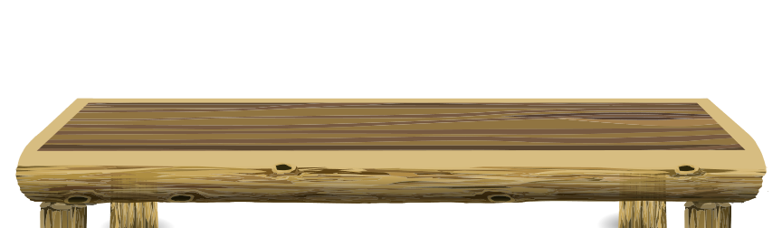

While 90 percent of teachers reported participating in professional development, most of those teachers also reported that it was totally useless.
Research Shows
(Darling-Hammond et al, 2009)
Notes:
After fourteen years the current model of professional development has still not changed significantly. Educators are given exciting ideas to implement, but translating those new concepts to the classroom continues to be difficult for five reasons covered later in this presentation. This leaves the vast majority of educators with the opinion that PD is a big waste of time that could be better spent working in our classrooms on lessons. Ironically, these are the same tired lessons that model the issues that the PD attempted to change in the first place.

Slide 3
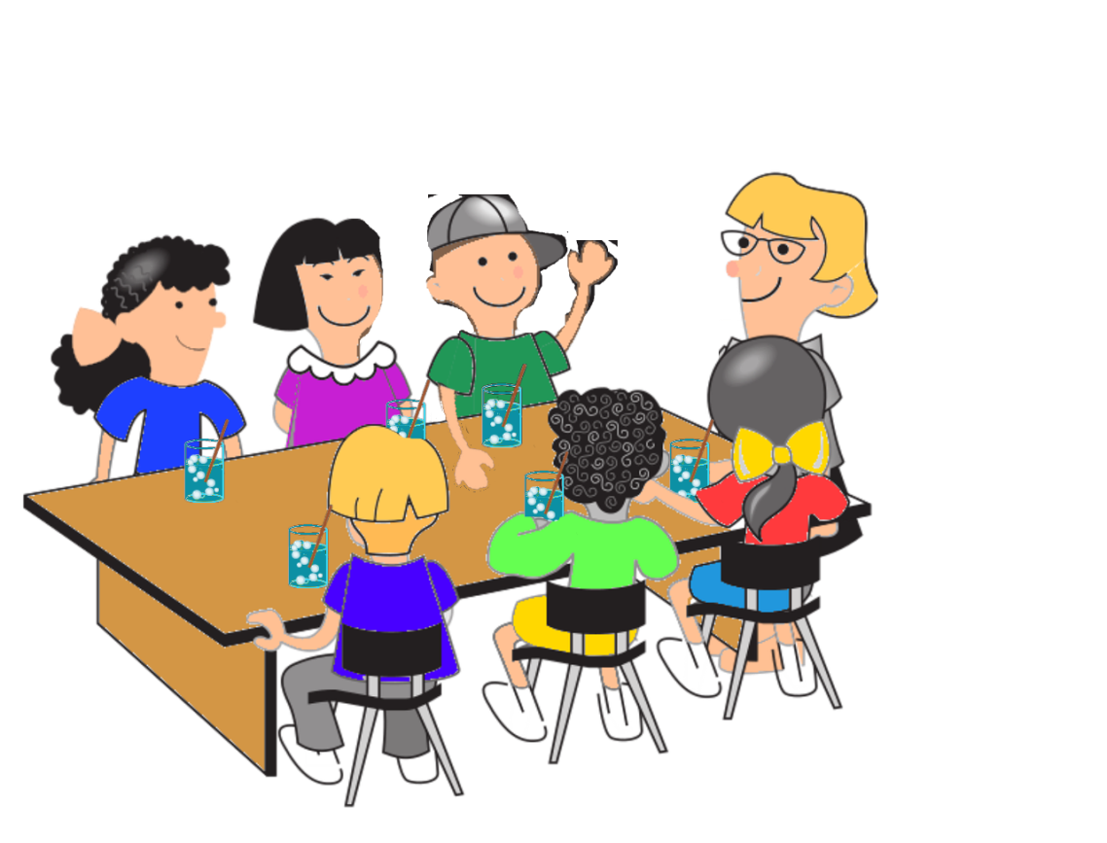

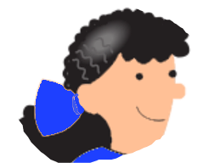

Learning
1
Passive
Active
Notes:
All too often, teachers are subjected to sit’n’get learning that is frowned upon in the classroom. According to David Phillips (2014), people learn more when engaged and when simulation is purposeful, meaningful, and direct. Yet, teachers are subjected to walls of text and excessive amounts of clever imagery to try to make a point in our PD. This detracts from the message and, rather than capture the minds of professionals, causes disengagement instead (Phillips, 2014).
TedTalk. (2014). How to avoid death By PowerPoint. YouTube. Retrieved February 7, 2023, from https://youtu.be/Iwpi1Lm6dFo.

Slide 4
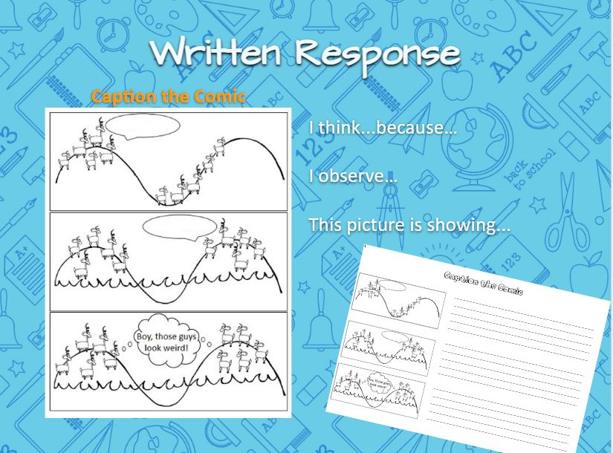
PD should be specific to the discipline
2
Notes:
Provided is a slide from a Science PD Summer Academy held in 2018. This image shows a picture that helps learners think critically. This example is in Biology, yet I teach Astronomy. Despite the difference in domains, I was not given time to create my own version of this strategy. I loved the concept, but when I returned to my classroom, I couldn’t figure out how to implement it based on the rest of the PD discussion. This is the only information I have from that concept since no time was provided to process or contextualize for other domains or even other topics within Biology. Due to lack of time, I set the concept aside and now only pulled it back out to illustrate my point that a great concept that fails to connect falls flat. I have no experience teaching Biology so transitioning this concept to my classroom would require a significant amount of work on my part. Educators need professional development that is transferable; however, this idea requires a significate time investment. The creation of concepts such as these is complex and would require deep content knowledge, creativity, and ongoing support from other professionals to effectively implement within a variety of domains.

Slide 5
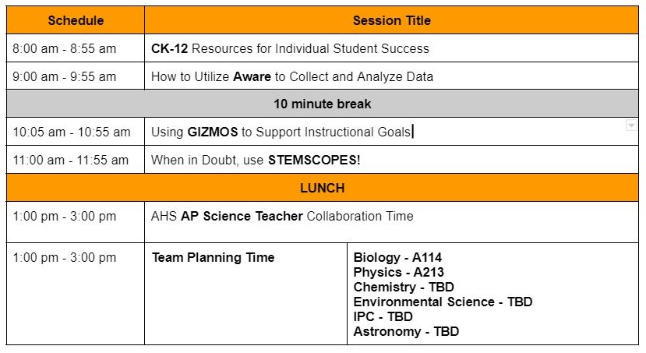

Significant and Ongoing
3
Notes:
This past summer academy, our morning instruction was filled with 4 different strategies for which we spent one hour each. We moved so fast that the teachers had no time for processing. The handouts were massive and ongoing support was non-existent. We had this PD 8 months ago and have yet to revisit any of the strategies. As people in the business of educating others, we have seen what skills are picked up by our learners when no further guidance is given. Some of these task were complex, some were fairly straightforward depending on your existing technology skills, but none of it was easy to remember with just one instance of the concept. Let’s zero in on the first session: here you see 8 different topics of material that are each quite extensive with just one of these topics requiring days and days to go through, modify, and implement properly. Yet we only spent an hour on a few of them flipping through tabs and barely toying with end concepts. Overall, it was completely chaotic, with the rest of the day following suit.
(Hit space bar)
Thalmann (2019) shows how people are not capable of remembering a long list of information due to limitations from our short to long term memory storage.
Thalmann, M., Souza, A. S., & Oberauer, K. (2019). How does chunking help working memory? Journal of Experimental Psychology: Learning, Memory, and Cognition, 45(1), 37–55. https://doi.org/10.1037/xlm0000578

Slide 6



Modeling is Highly Effective
4
Notes:
Just learning a new idea is not enough. No one explains to a person how to drive, then throws them the key, and walks away, at least no one who wants the car to remain in one piece. Each person needs to have time to become familiar with the concept and see it in action. They must practice implementation and finally strike out to achieve success on their own. Thalmann (2019) found that chunking helps a person take short term memory and convert that knowledge into something that can be retained for use at a later moment. These findings have been backed by decades of research, yet our current PD is littered with massive data dumps without time to digest any concepts. Throughout an educator’s time as a professional, they are forced to go to professional development trainings that they find to be ineffective for this very reason. Honing our skills to reach the organization’s most important goal, through practicing and demonstrating those required skills, is pinnacle of professional development that moves professionals that merely acquiesce to listen to full scale engagement. Effective PD must take professionals that find no value in the lesson to being capable of visualizing how they would apply it to their work life situation.

Slide 7
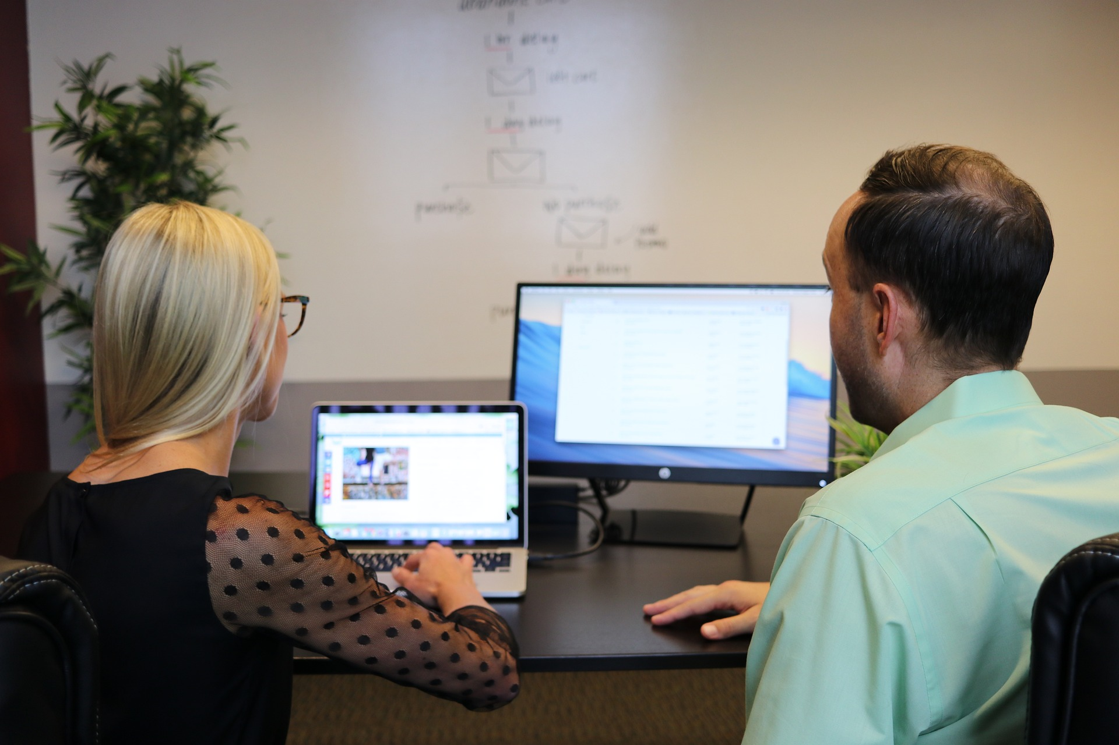
Ongoing Support
5
Notes:
As a learner endeavors to acquire a new skill, an educator or coach would not do them justice by only giving them one lesson and sending them on their way. Most of these skills require practice and confidence to use the new skill. When a teacher learns a concept in PD they must see it modeled and must be supported as they implement the new concepts if the instructor/coach wants them to succeed at the skill.

Slide 8

Notes:
It is time for PD to become more than it currently is. PD should allow for everyone involved to feel like they are accomplishing something, not just checking a box.

