Slide 1
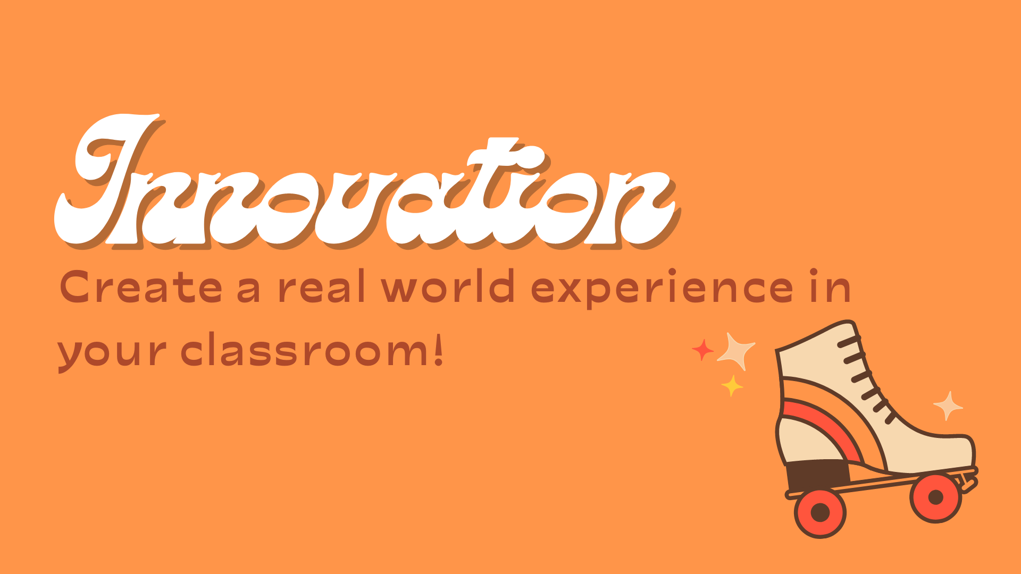

Slide 2
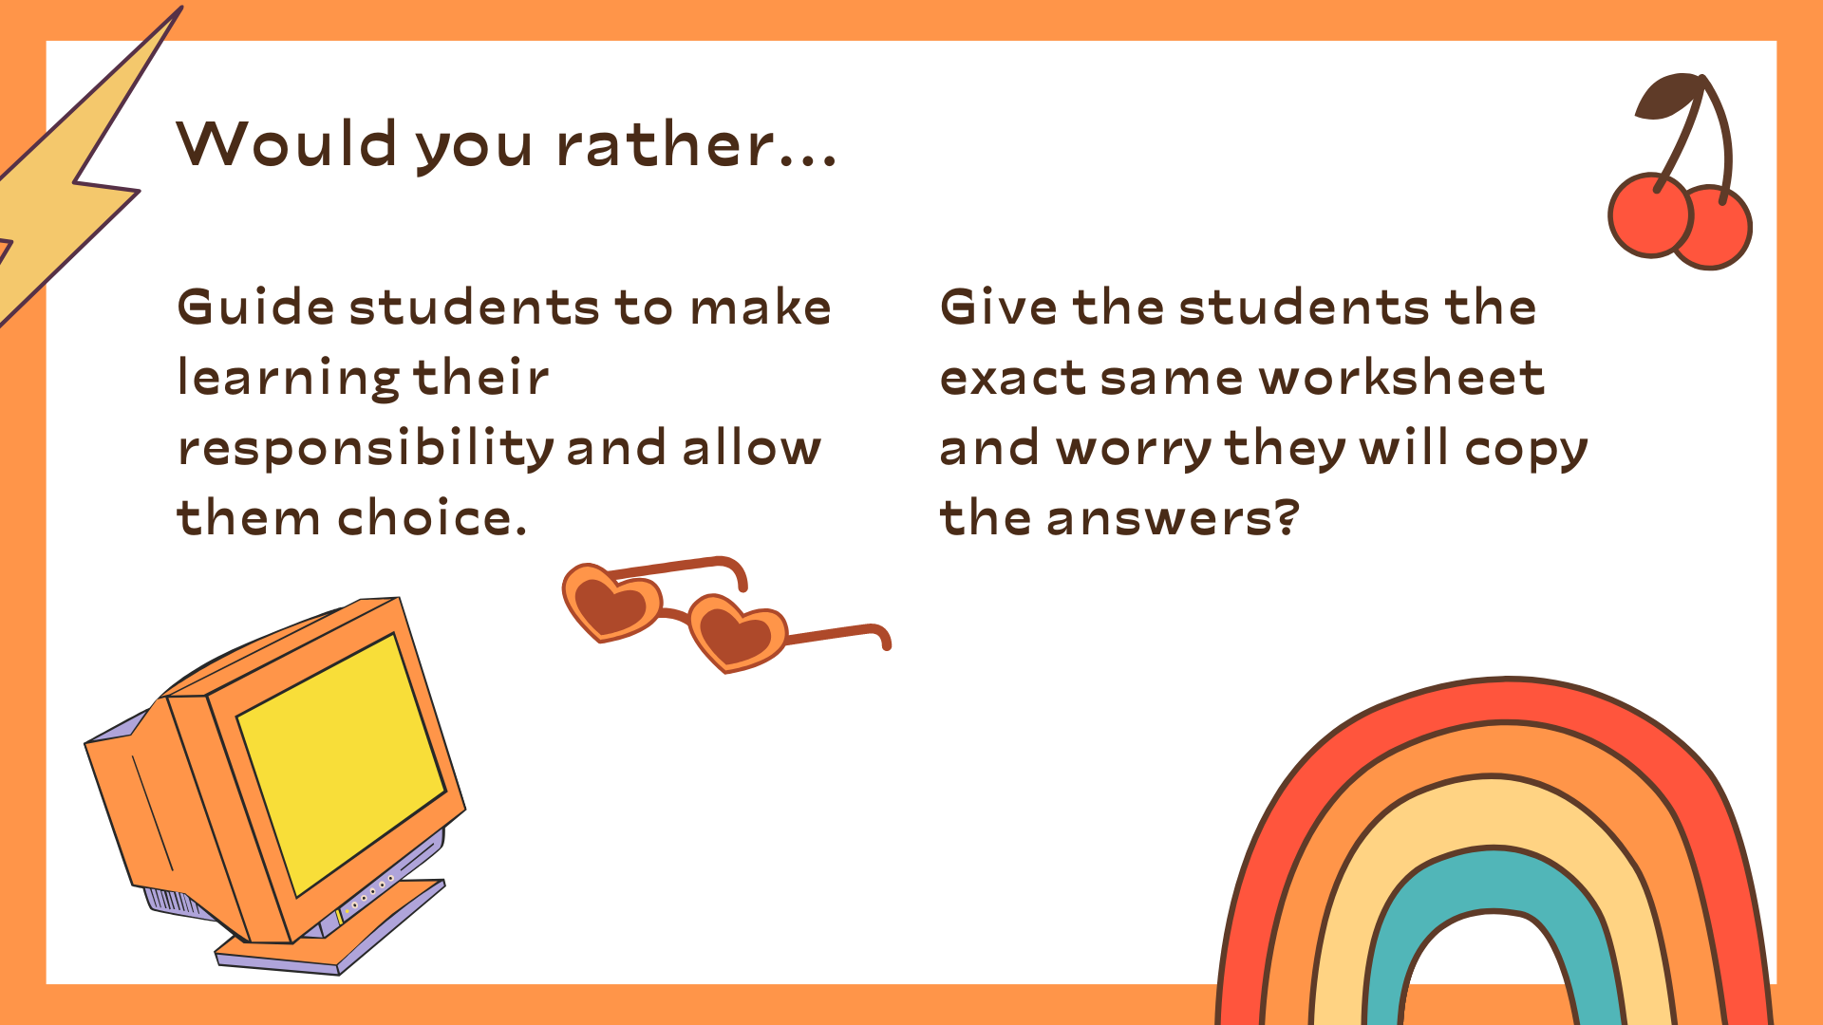

Slide 3
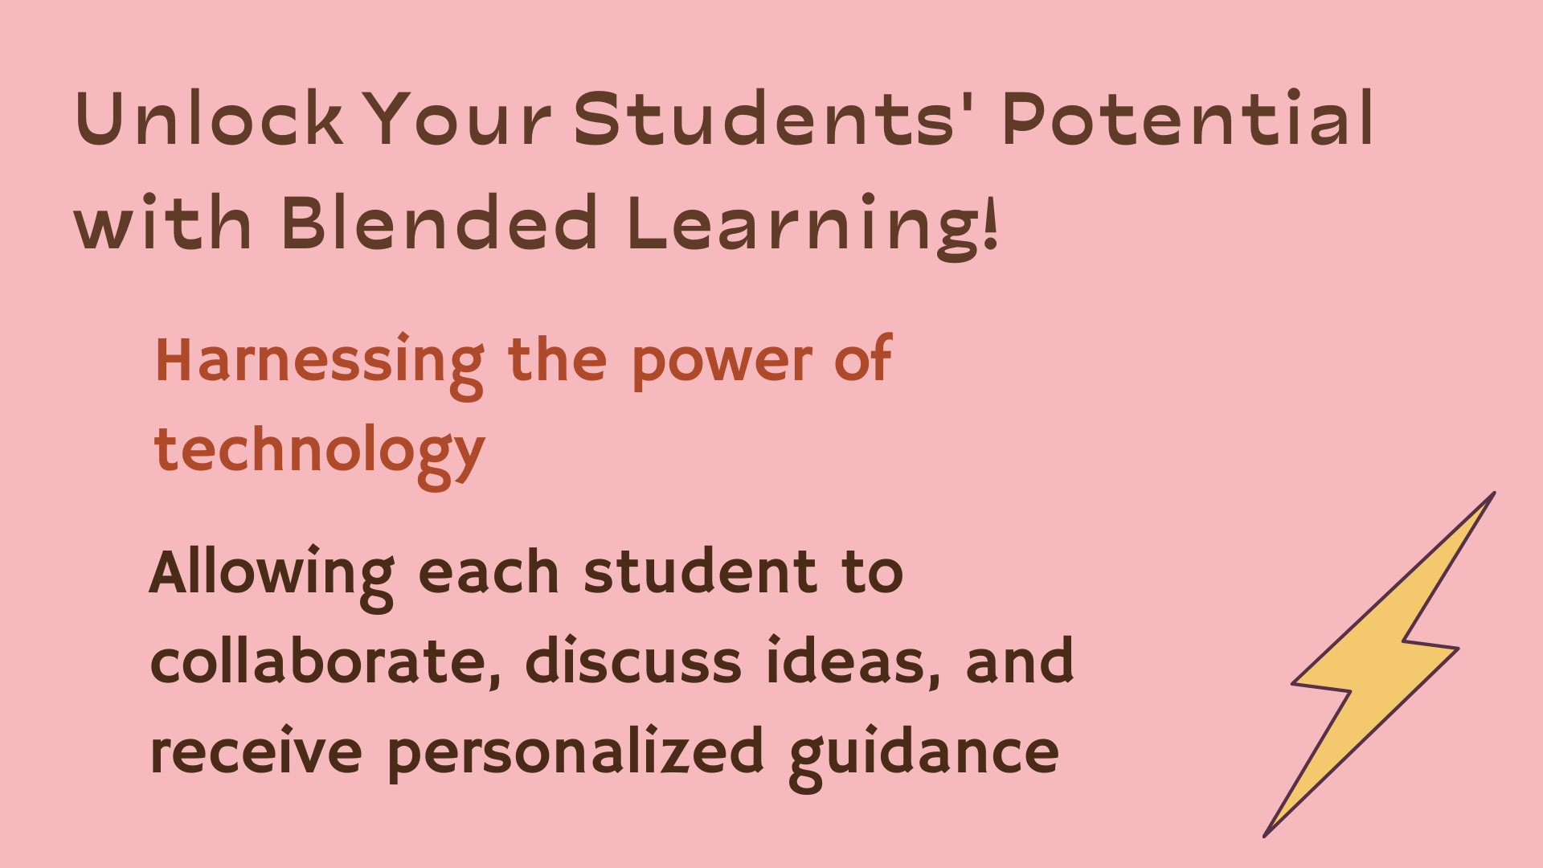
Notes:
Unlock Your Students' Potential with Blended Learning! Our innovative approach combines the best of both worlds: online and in-person instruction. With Blended Learning, your students can embrace a personalized and interactive educational journey.
Harnessing the power of technology, we provide engaging online lessons accessible from anywhere, fostering flexibility and self-paced learning. Students can review materials, watch videos, and complete interactive exercises at their own pace, strengthening their understanding of key concepts.
But we don't stop there! In-person sessions offer valuable face-to-face interactions, allowing students to collaborate, discuss ideas, and receive personalized guidance from our dedicated educators. They benefit from a supportive learning environment and build essential social skills.
Blended Learning empowers your students to become active learners, maximizing their academic growth and preparing them for success in a dynamic world.

Slide 4
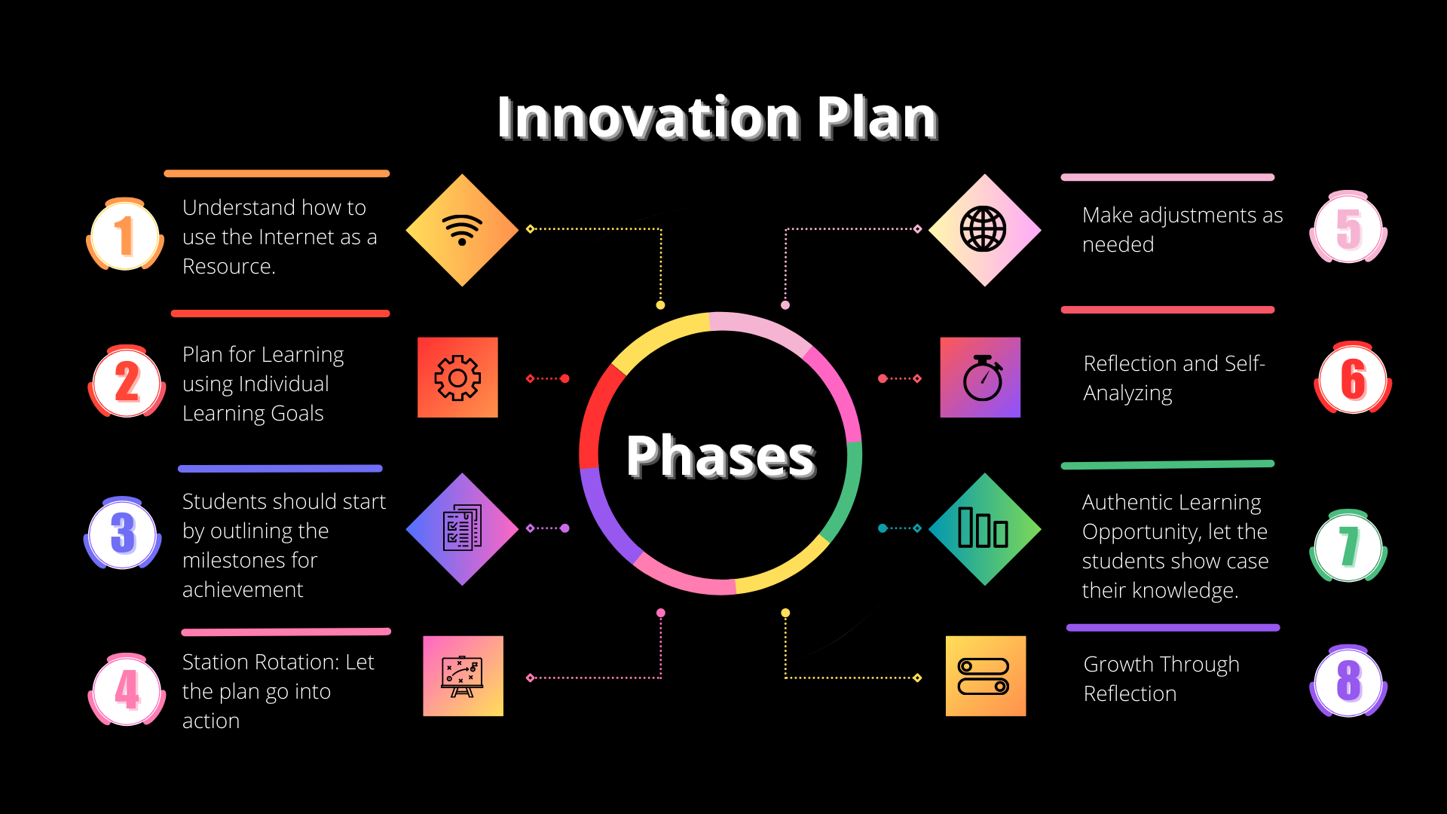

Slide 5
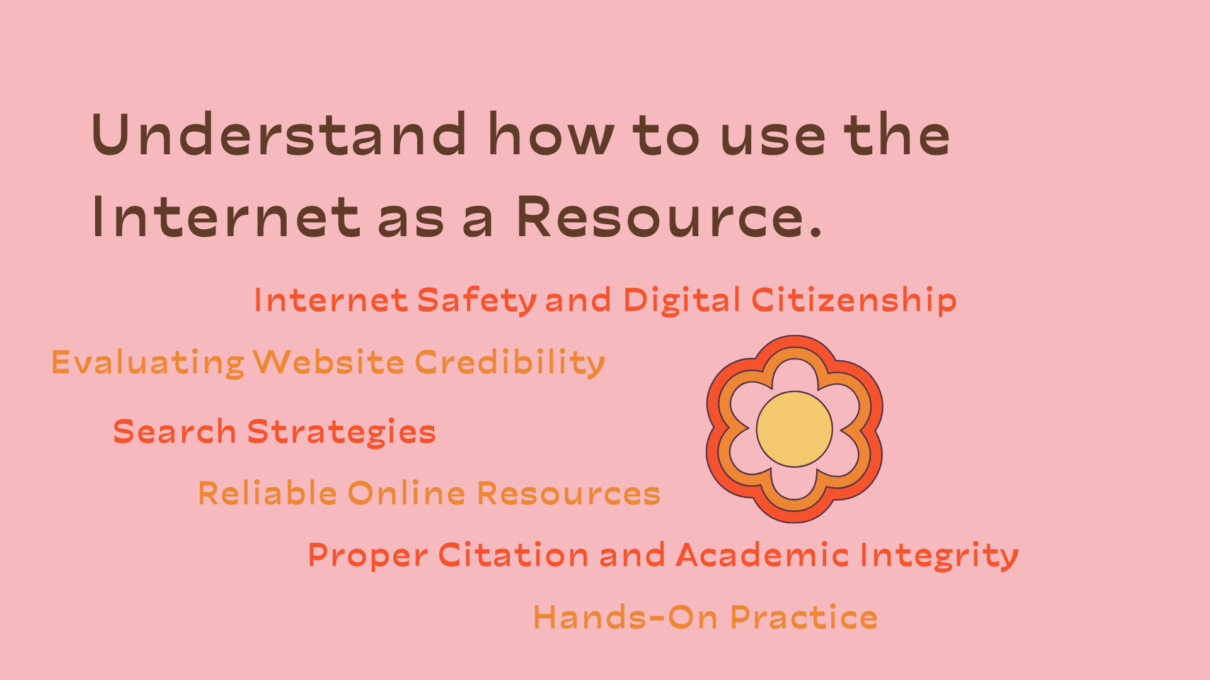
Notes:
In today's digital age, instilling online safety and responsible digital citizenship in our students is of utmost importance. Through our blended learning approach, we prioritize addressing common risks such as cyberbullying, identity theft, and privacy concerns. We educate students on the significance of practicing online etiquette, understanding copyright laws, and citing sources appropriately.
Our comprehensive program delves into the critical skill of discerning website credibility and identifying reliable sources. We equip students with the tools to evaluate factors such as authorship, domain authority, and bias, enabling them to make informed decisions about the information they encounter online. By providing practical examples of credible websites and assessing their reliability, we empower students to become savvy digital consumers.
Moreover, we emphasize effective search strategies for accessing relevant and reliable information. Through demonstrations on search operators, utilizing keywords, and leveraging advanced features to refine results, students become proficient in conducting thorough research. We emphasize the importance of cross-referencing information from multiple sources to enhance accuracy and comprehensiveness.
In our blended learning environment, we introduce students to reputable resources such as academic databases, digital libraries, and educational websites. We guide them in accessing and navigating these platforms, allowing them to tap into a wealth of knowledge relevant to their subject areas or topics of interest. Furthermore, we emphasize the importance of proper citation and giving credit to original sources. Students are introduced to citation styles like APA and MLA and are guided through the process of citing online sources accurately.
To reinforce the significance of academic integrity, we discuss the consequences of plagiarism and encourage students to uphold ethical research practices. As part of the curriculum, we assign research tasks or projects that require students to explore online resources, evaluate website credibility, and find reliable information. Throughout the process, our educators circulate the classroom, offering guidance and support, ensuring that students make the most of the vast array of online resources available to them. Together, we foster responsible digital citizenship and equip students with the skills to navigate the digital landscape with confidence and integrity.

Slide 6
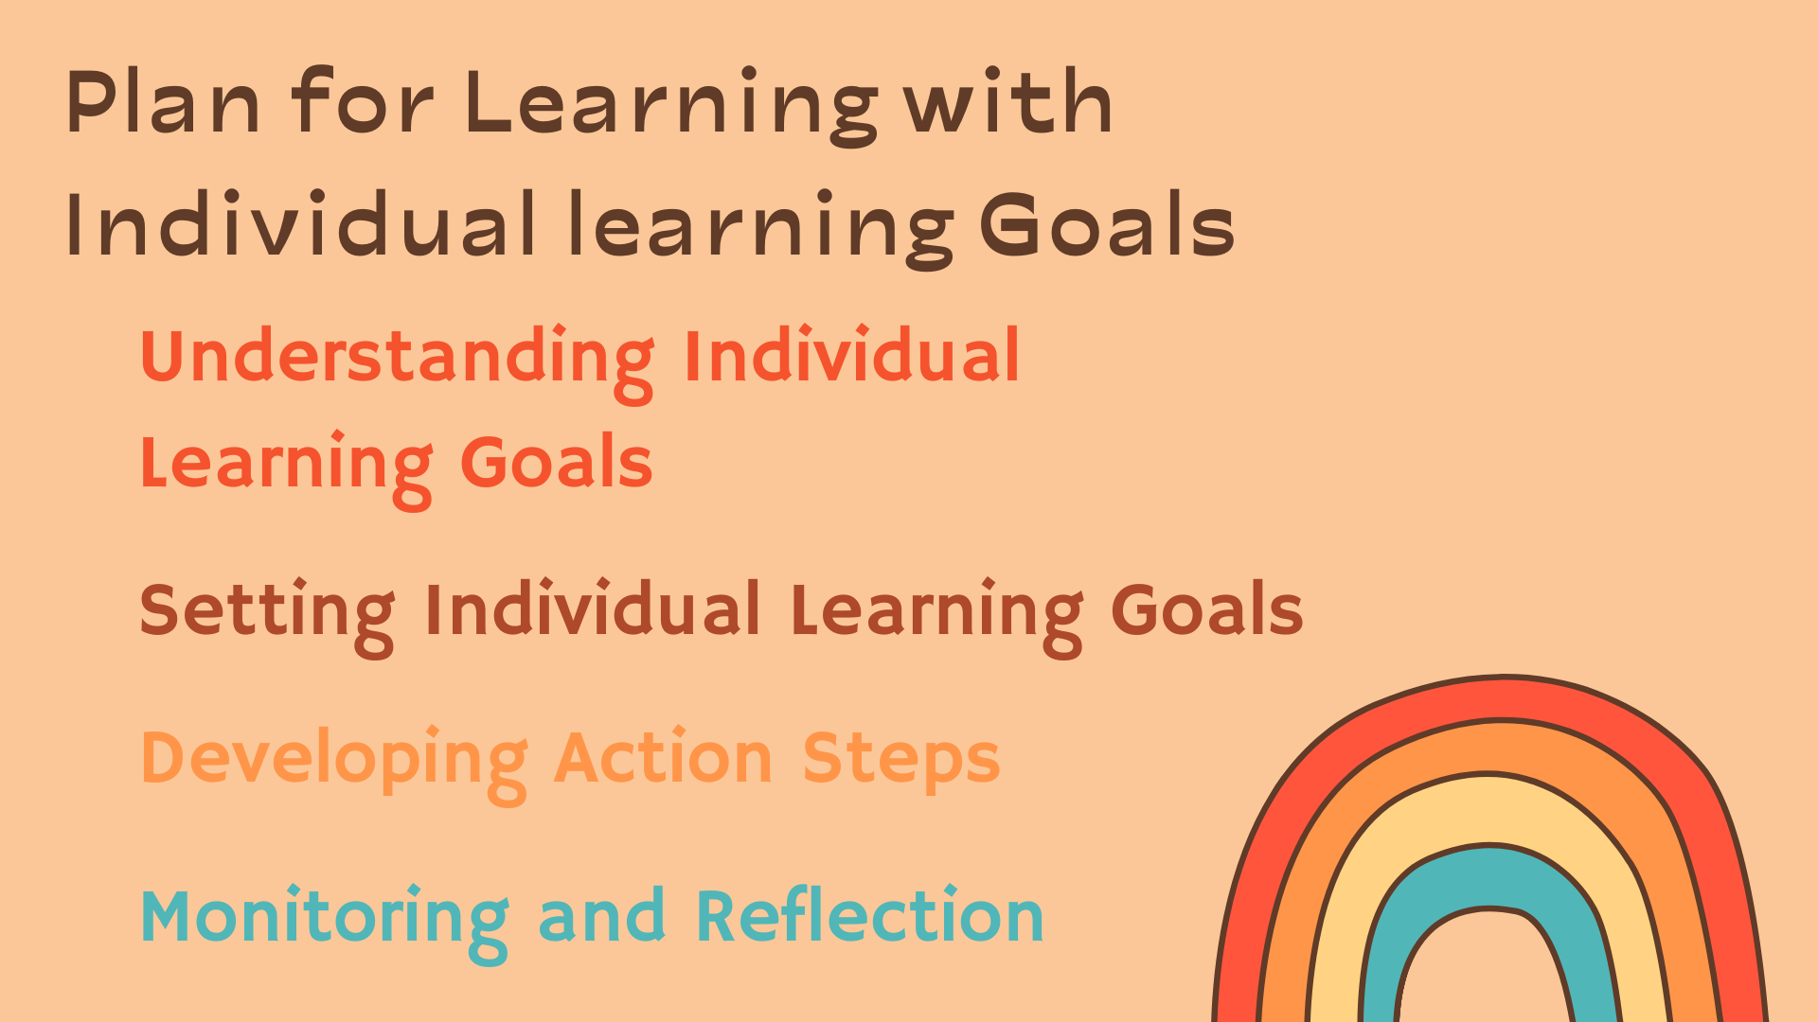
Notes:
Discussing learning goals allows us to have a clear direction and purpose in our educational journey. Take a moment to share your understanding of what a learning goal is and how it can help you improve your learning. Together, we will highlight the benefits of setting SMART goals—goals that are specific, measurable, achievable, relevant, and time-bound.
Next, I will distribute the Individual Learning Goal Worksheet to each of you. This worksheet will guide you in creating your own individual learning goals and developing a plan to achieve them. It consists of different sections, including the goal statement, action steps, resources needed, and target completion date. Remember the importance of being specific and realistic when setting your goals.
Now, it's time to engage in setting your learning goals. Brainstorm and identify one specific learning goal that you would like to achieve. Consider your strengths, areas for improvement, and your interests when selecting a learning goal. This goal could be related to a particular subject, skill, or personal development area.
Once you have established your learning goal, it's time to extend your thinking by developing action steps. Break down your learning goal into actionable steps on the worksheet. Think about the specific actions you need to take in order to achieve your goal. Consider any necessary resources, such as books, websites, or materials, that will support your learning process.
As we progress in our learning journey, it's crucial to monitor our progress towards our learning goals. Take the time to periodically reflect on your progress and make any necessary adjustments to your action steps or timelines. Reflection plays a significant role in the learning process, providing us with opportunities for self-improvement and growth.
Now, let's create a supportive and respectful environment by sharing our learning goals and action steps with our peers. This sharing and discussion session will allow us to gain insights from one another and provide valuable feedback. Pay attention to the similarities and differences among the goals and strategies identified by your classmates, as they might inspire new ideas or perspectives.

Slide 7
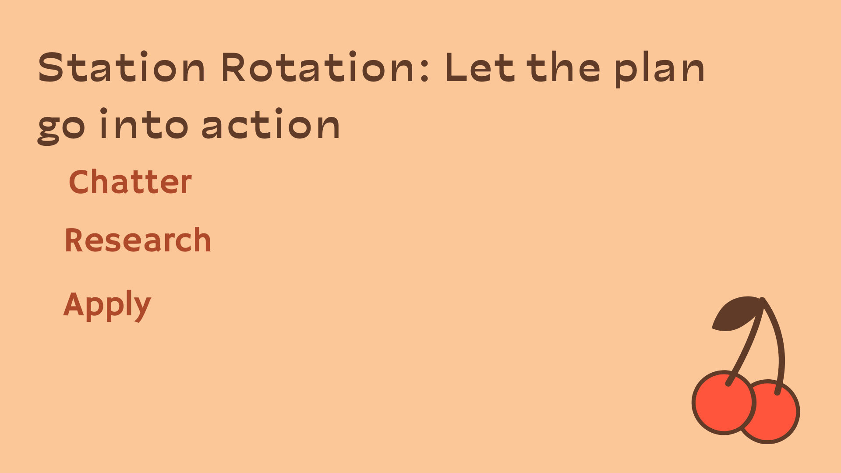
Notes:
These stations are designed to provide students with a well-rounded and engaging learning experience. Today, we have three stations that students will rotate through: Chatter, Research, and Apply.
At the Chatter station, students will have the opportunity to discuss what students are learning with your peers. Engage in meaningful conversations, share your insights, ask questions, and collaborate on understanding the subject matter. This station encourages active participation, critical thinking, and effective communication skills.
The Research station is where students can dive deeper into your learning by utilizing various resource tools such as technology or books. Students will have access to a wealth of information that will support your understanding and help students explore different perspectives. Use search engines, digital libraries, textbooks, or any other relevant resources to conduct research and gather information.
The Apply station is where students will put your knowledge into action. Students will have tasks or assignments to complete that allow students to apply what students have learned. These tasks may include answering guided questions, solving problems, conducting experiments, or completing physical assignments. This station helps students solidify your understanding through hands-on practice and real-life application.
Throughout the day, students will rotate through these three stations, spending a designated amount of time at each one. This rotation will ensure that students engage in a variety of learning experiences and develop a comprehensive understanding of the subject matter.
Remember to make the most of each station by actively participating, asking questions, seeking clarification, and collaborating with your peers. Take advantage of the resources available to students during the Research station to enhance your knowledge and broaden your perspectives. And finally, apply what students have learned at the Apply station to reinforce your understanding and develop practical skills.

Slide 8

Notes:
As a teacher, it is crucial to engage in regular reflection to continuously improve your teaching practice. Reflection allows you to assess what is working well and identify areas that need improvement. Here are a few key points to consider during your reflective practice:
Firstly, take time to reflect on your instructional strategies and methods. Consider the engagement levels of your students, their understanding of the content, and their overall progress. Ask yourself if your teaching approaches effectively cater to the diverse needs and learning styles of your students.
Reflect on the learning environment you create in your classroom. Is it supportive, inclusive, and conducive to student growth? Consider the classroom management techniques you employ and how they impact student behavior and participation. Seek feedback from your students to gain insights into their experiences.
Evaluate the effectiveness of your assessment practices. Do your assessments align with your learning objectives? Are they providing you with meaningful data on student progress and areas for improvement? Reflect on the feedback and support you provide to your students to ensure it is constructive and helps them grow.
Reflect on your communication and relationship-building with students and parents. Are you fostering open lines of communication, actively listening to student voices, and maintaining positive connections? Evaluate how you provide feedback and celebrate student achievements, as well as how you collaborate with parents and guardians.
Lastly, consider your own professional growth and development. Reflect on the areas where you excel and the areas where you may need further training or support. Seek out professional development opportunities, connect with colleagues, and stay up to date with educational research and best practices.
By engaging in regular reflection, you can enhance your teaching practice, make necessary adjustments, and create a positive and effective learning experience for your students. Remember that reflection is a valuable tool for continuous improvement and professional growth as an educator.

Slide 9
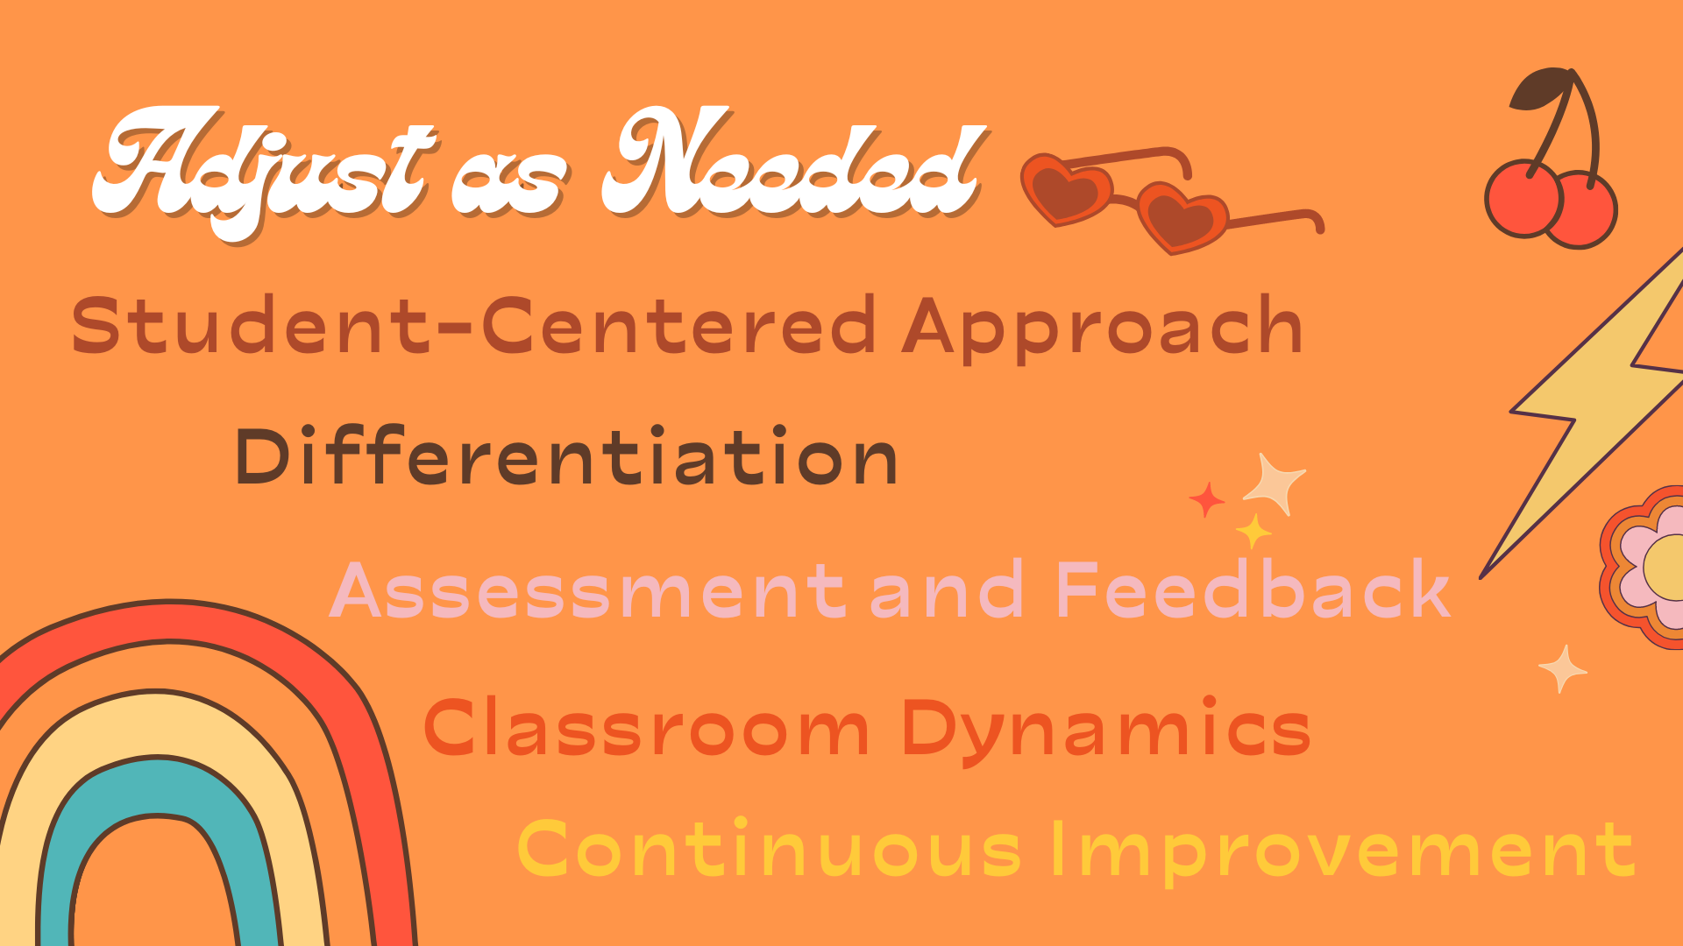
Notes:
Effective educators understand the importance of being flexible and adaptable to meet the unique needs of their students and classroom environment. Here are a few reasons why adjusting to fit the classroom is essential:
Student-Centered Approach: Each classroom is comprised of diverse learners with different abilities, learning styles, and backgrounds. Adapting your teaching methods and strategies ensures that you cater to the specific needs and interests of your students. By recognizing and accommodating these differences, you create an inclusive and supportive learning environment.
Differentiation: Adjusting your instruction allows you to differentiate the content, process, and products to meet the varying levels of readiness and learning preferences among your students. By offering a range of activities, assessments, and instructional materials, you can engage all learners and provide opportunities for success.
Classroom Dynamics: Each class has its own unique dynamics and atmosphere. By observing and understanding your students' interactions, interests, and challenges, you can tailor your teaching to create a positive and conducive learning environment. Flexibility allows you to address issues that may arise and foster a harmonious and productive classroom community.
Assessment and Feedback: As an educator, adjusting to fit your classroom also involves adapting your assessment methods and providing timely and constructive feedback. By aligning assessments with learning objectives and using varied assessment tools, you can gather accurate data on student progress. This information helps you tailor your instruction and provide targeted feedback to support students' growth and development.
Continuous Improvement: Adapting to fit your classroom is a sign of a reflective practitioner. Regularly reflecting on your teaching practice and seeking feedback from students, colleagues, and administrators allows you to identify areas that need improvement. By making adjustments based on these reflections, you can refine your teaching methods and enhance student learning outcomes.

